Slide 1
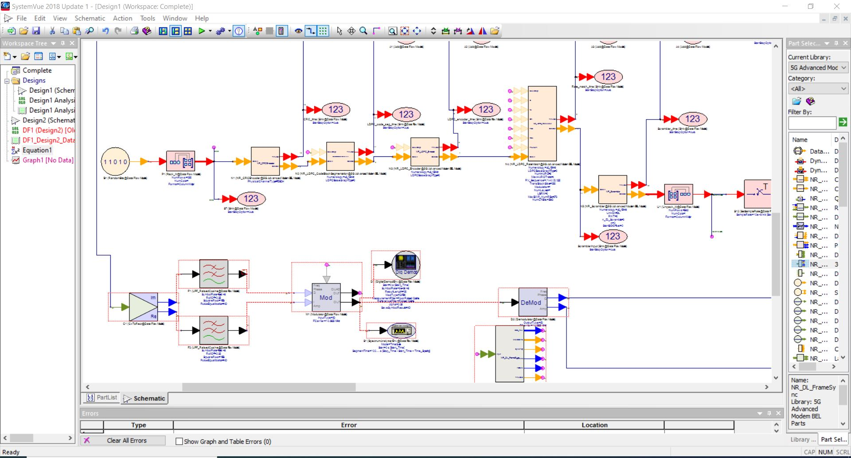
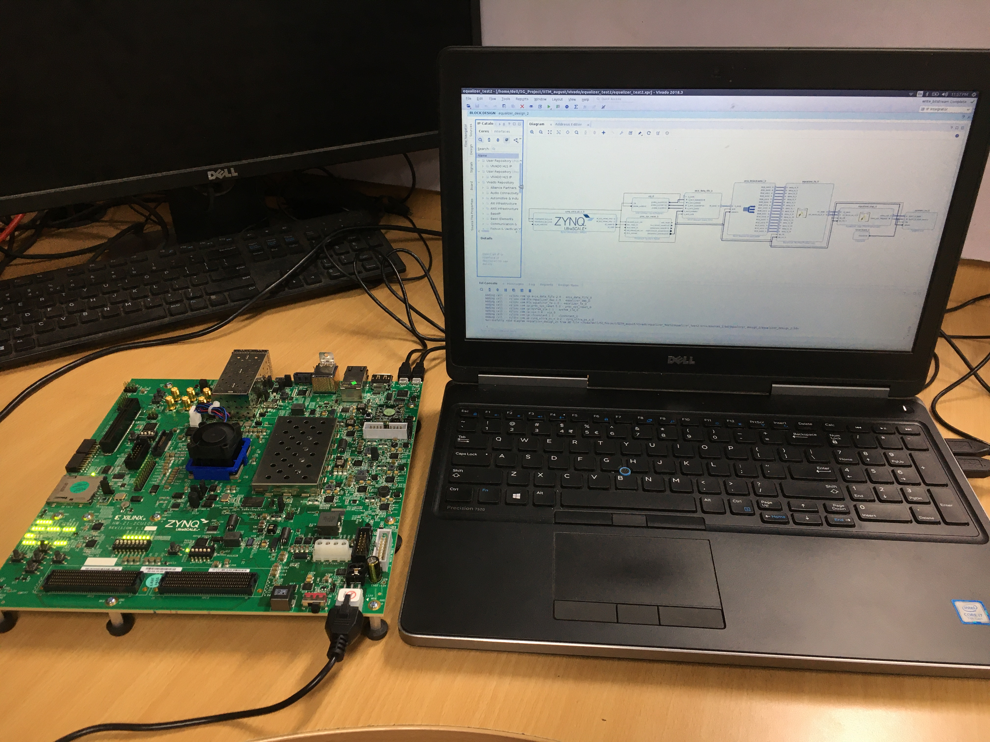
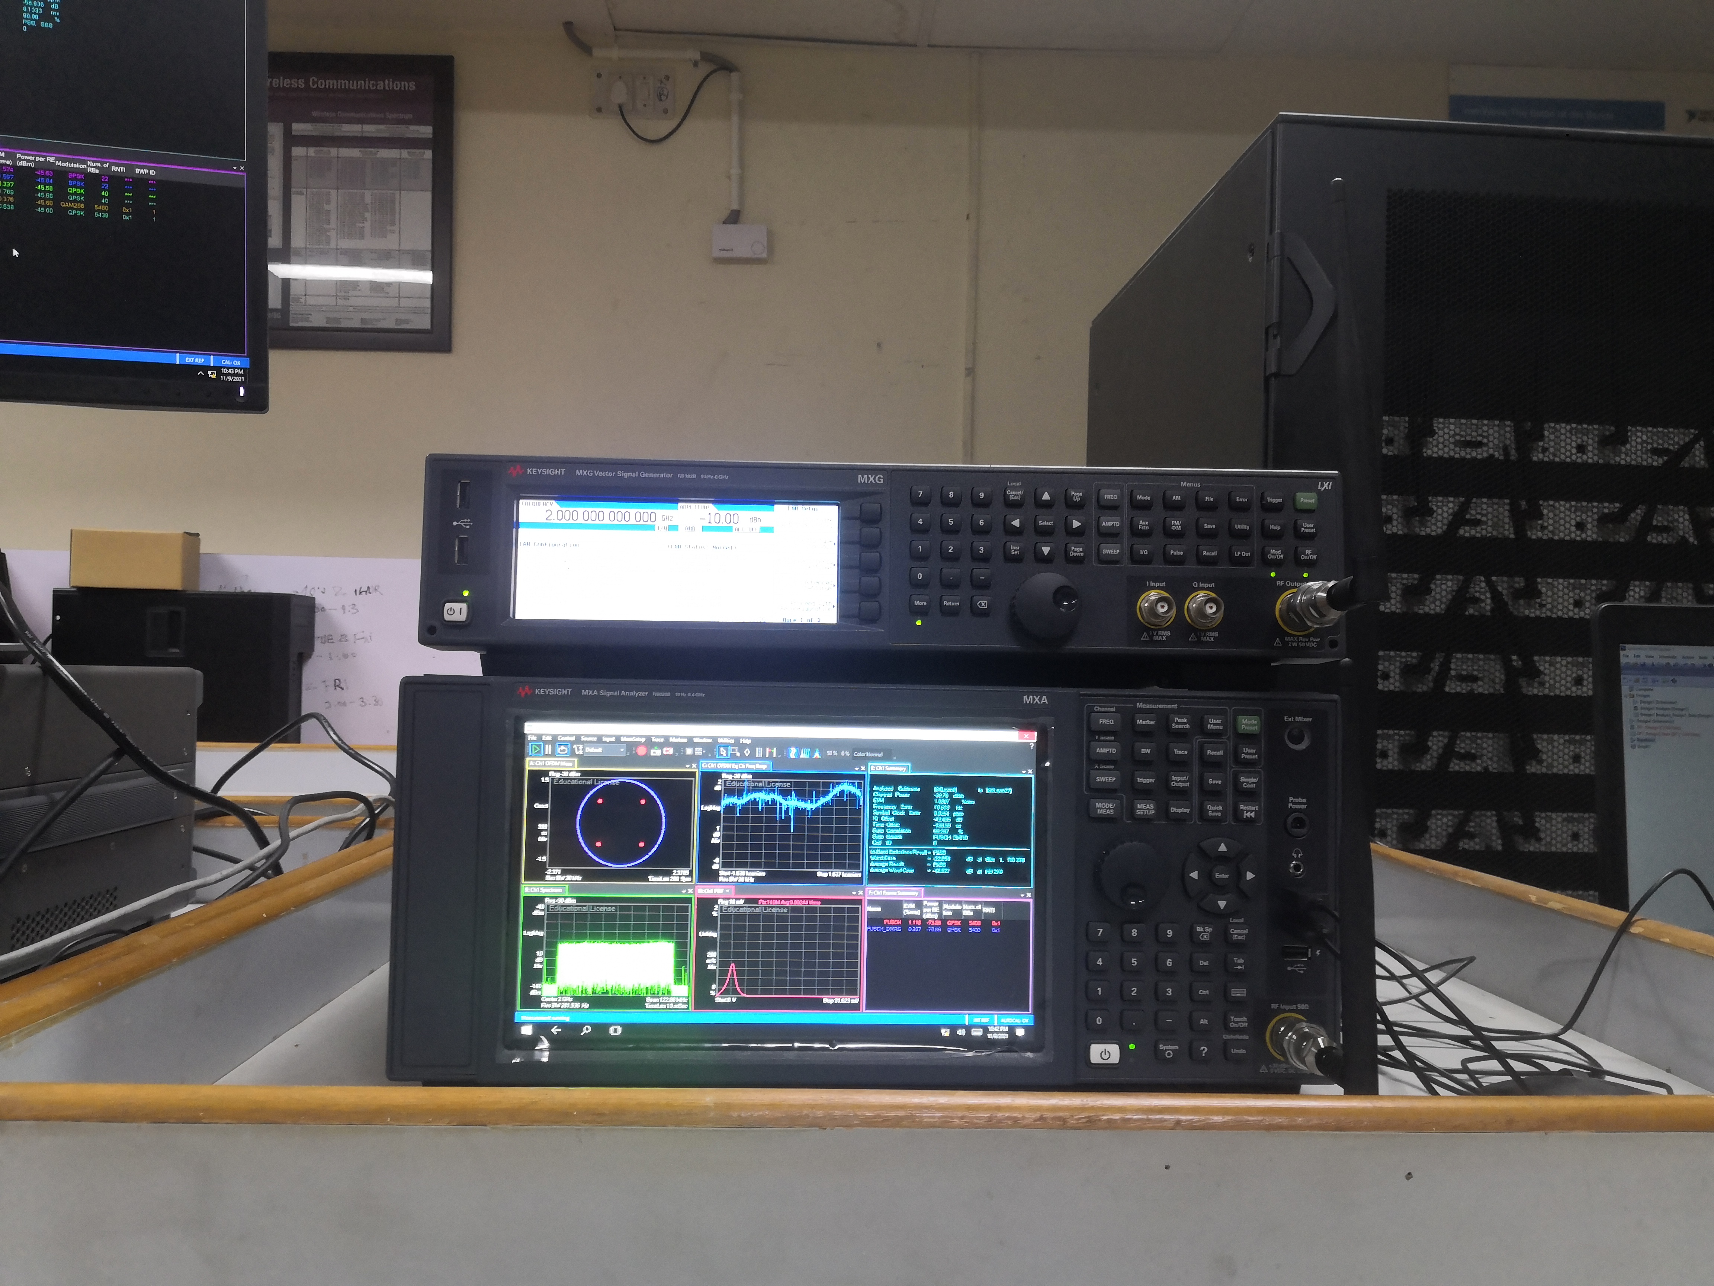
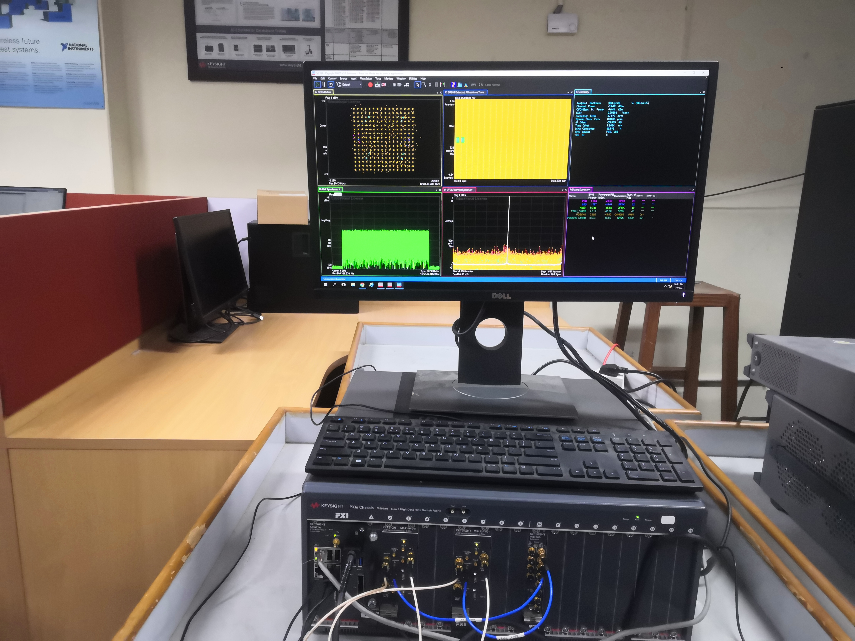
IIT Delhi – Baseband Algorithms for 5G NR
SystemVue based code generation
Real-time code execution
Algorithms developed for 5G Testbed
Channel equalization (sent to IITM)
Channel estimation (sent to IITM)
Blind decoding of PDCCH (sent to CeWit)
Value Proposition
Complete setup for development and testing of baseband algorithms for 5G NR
Tools:
SystemVue based generation of C and HDL code of 5G NR L1 modules
Vivado HLx suite + Zync Ultrascale ZCU102 FPGA for real-time code execution and performance analysis
Vector signal analyzer/generator and vector transceivers to test the 5G NR signals generated using SystemVue
Testing of 5G NR Signals
HIGHLIGHT: A complete setup for development and testing of baseband algorithms for 5G NR. Suited for use by Industry and Academia for development of baseband algorithms for 5G NR based applications.
Notes:
<number>

