Slide 1
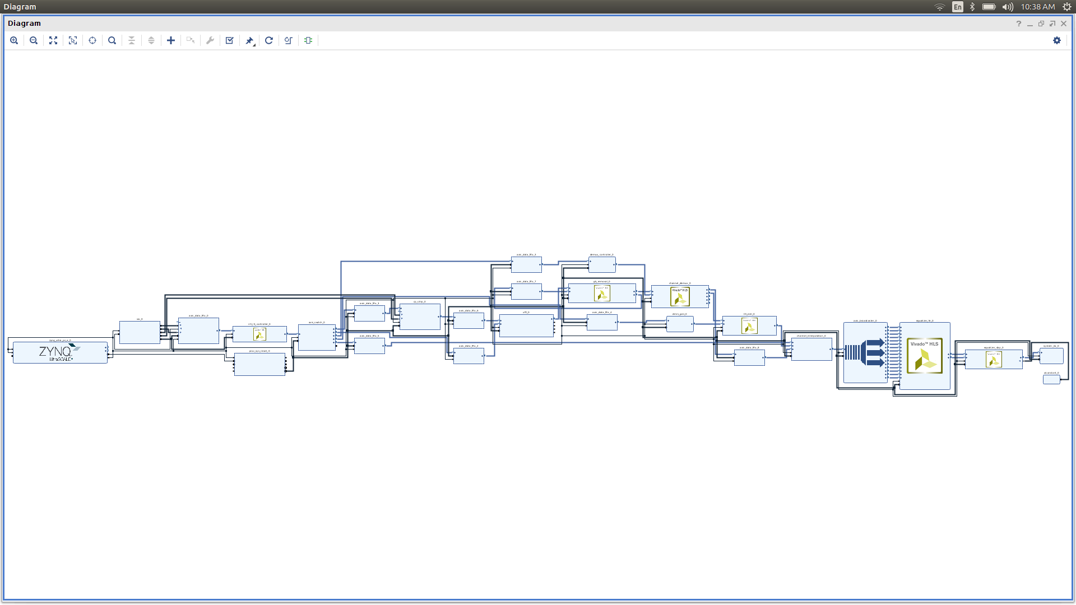
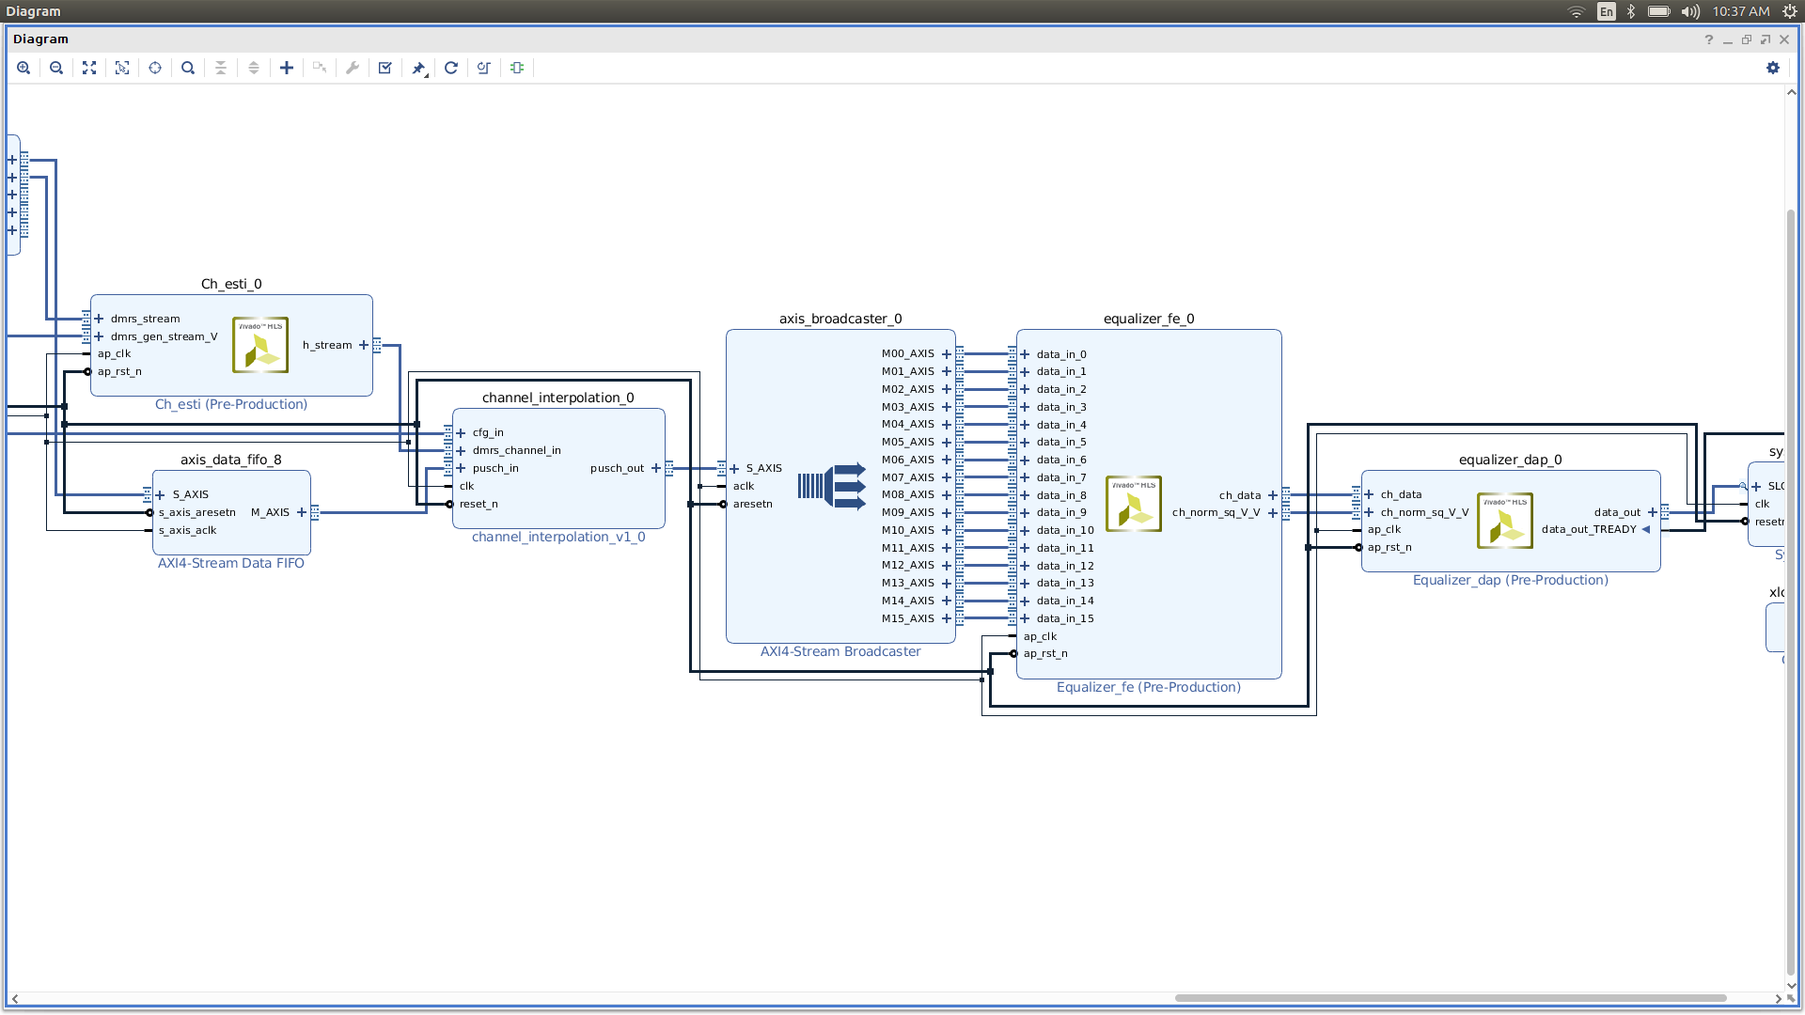
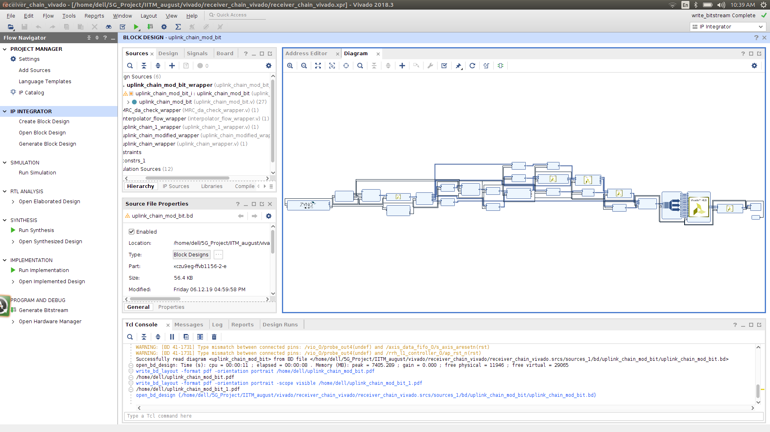
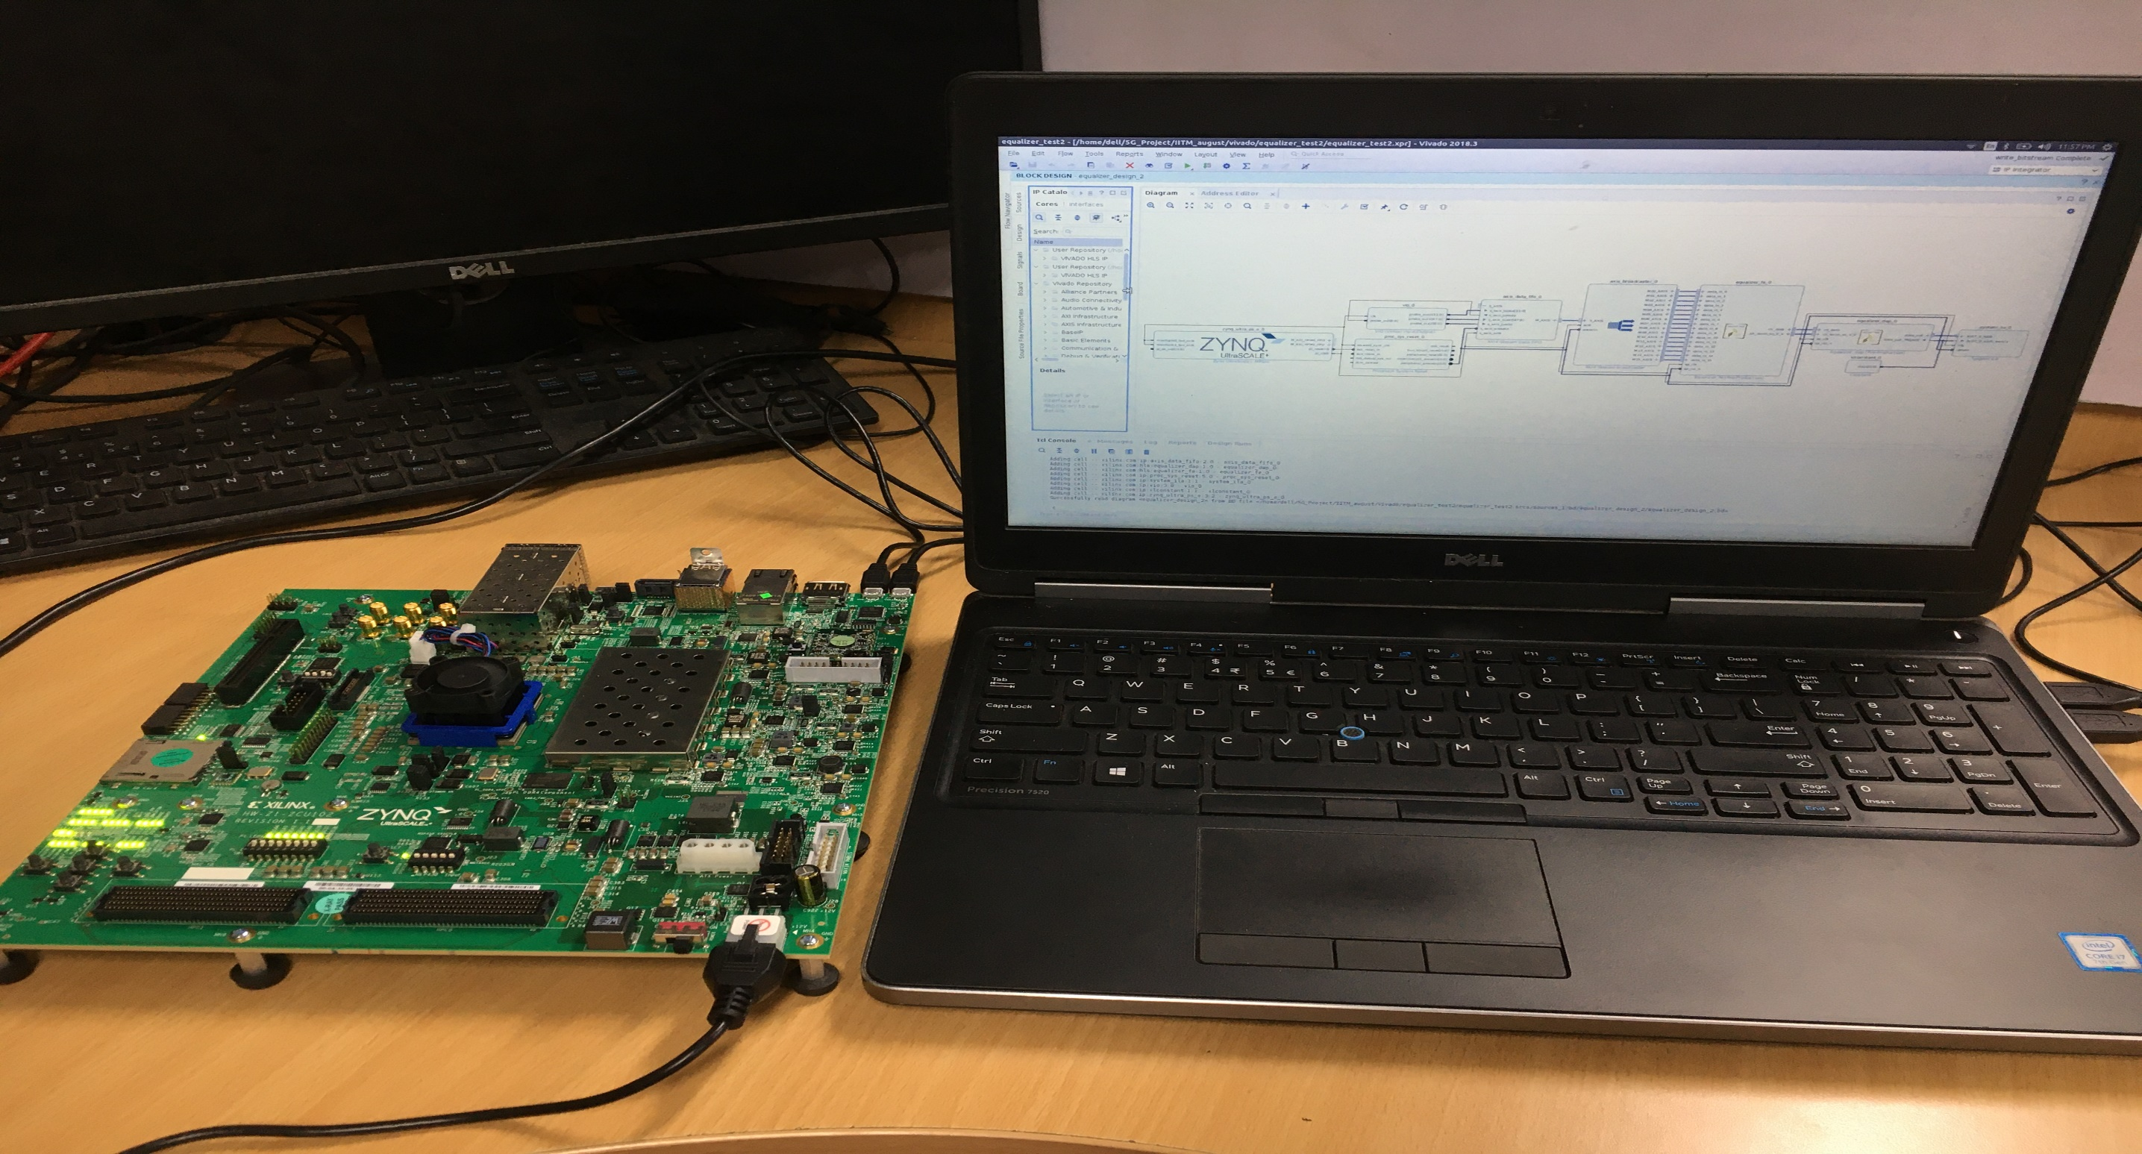
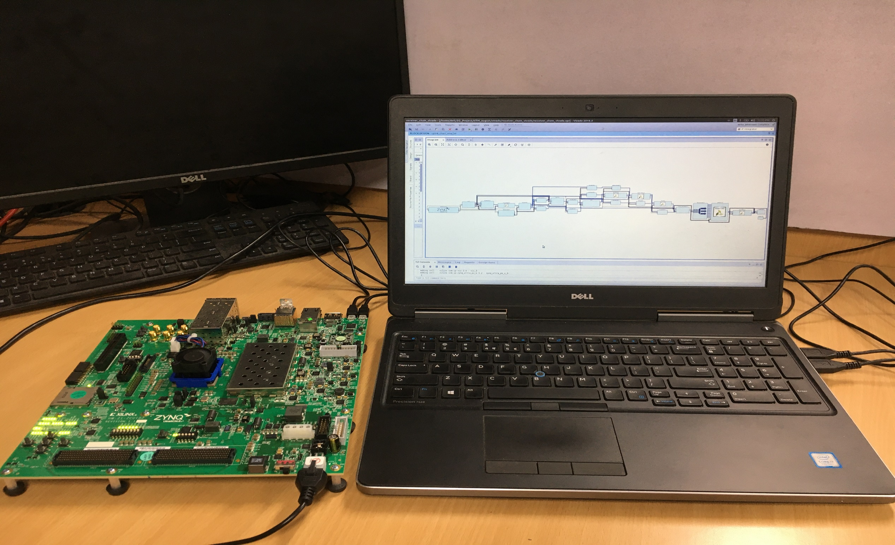
Baseband Algorithms for 5G NR
IIT Delhi, Delhi
5G Test Bed Project funded by Department of Telecommunications, Government of India
INDIAN INSTITUTE OF TECHNOLOGY, DELHI
Receiver Design in Vivado
Channel Estimation and Equalization IPs in Vivado
From Vivado to FPGA board
Generate Bit Stream
Export to the corresponding/connected Hardware
Launch software development kit (SDK)
Create a Project in SDK
Program FPGA board with the generated bit stream
Run the project
From Vivado to FPGA board
Xilinx Zync board Setup
This work was done in collaboration with IIT Madras.

