Slide 1
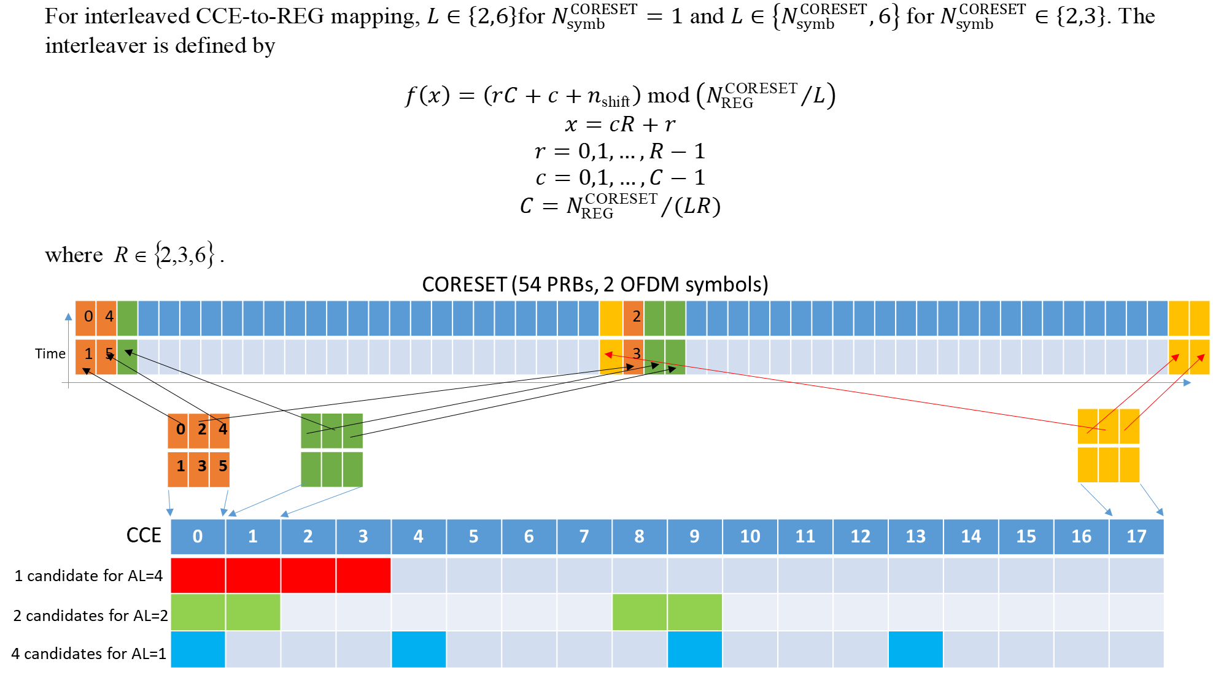
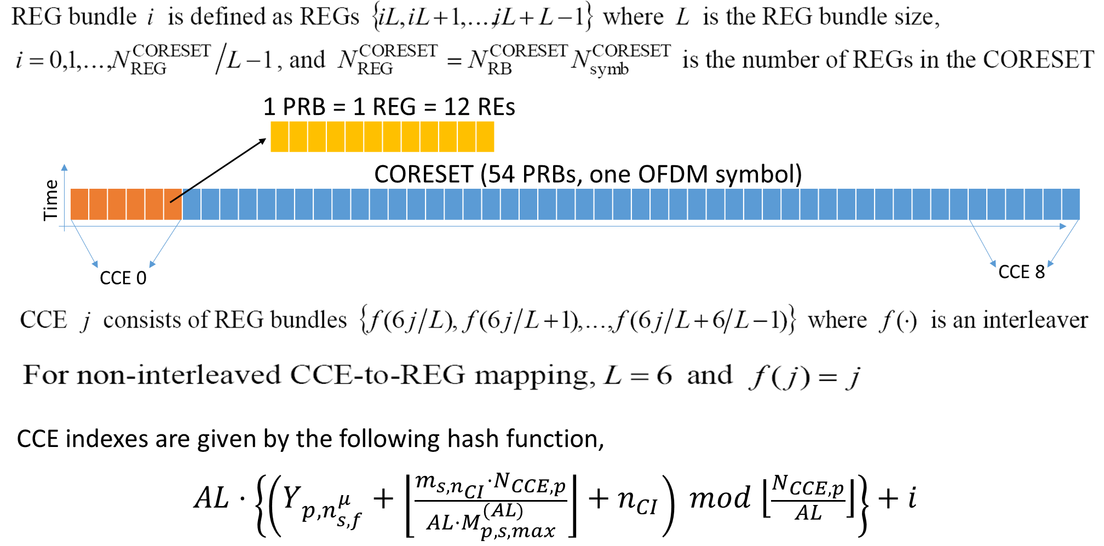
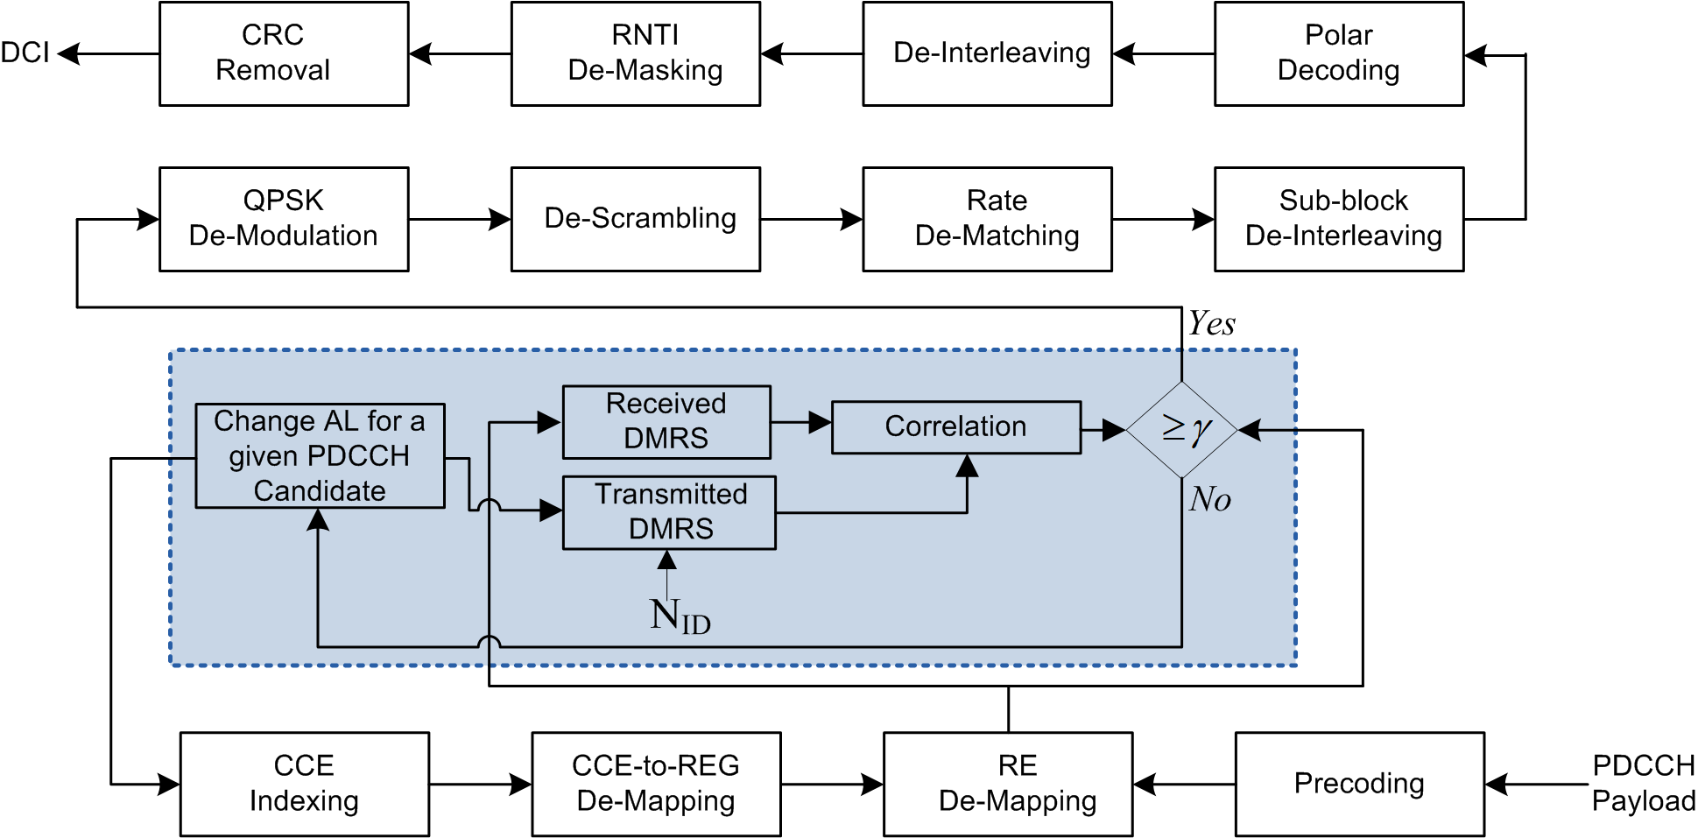
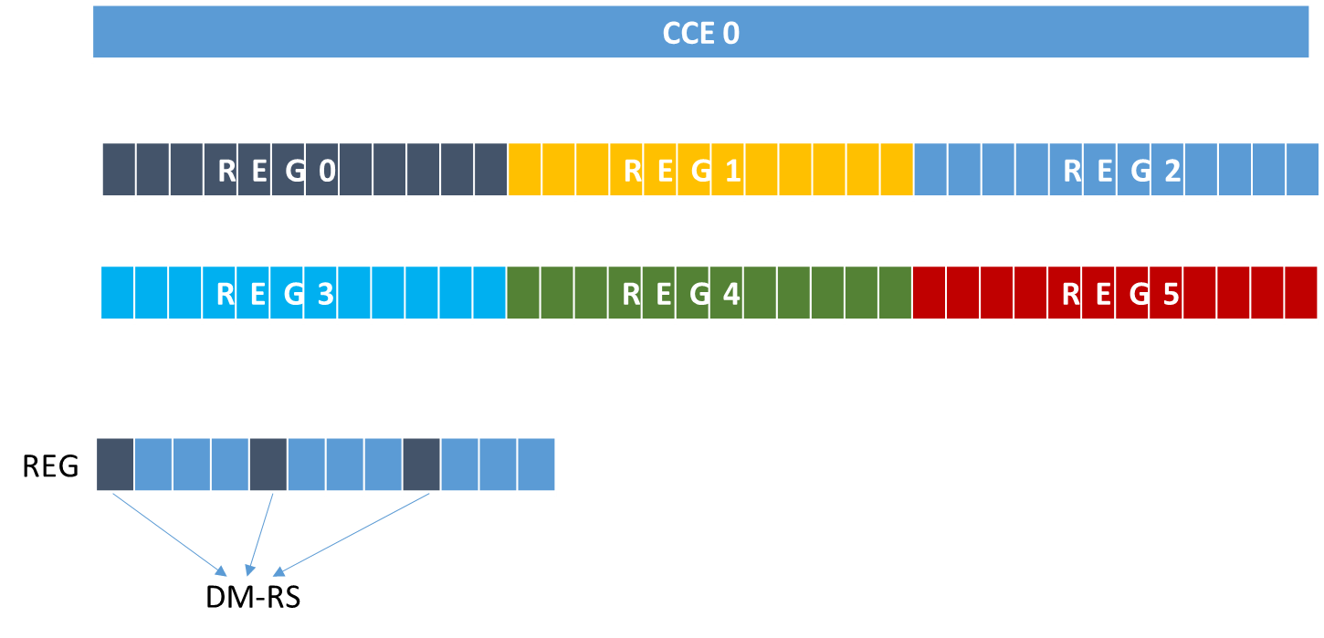
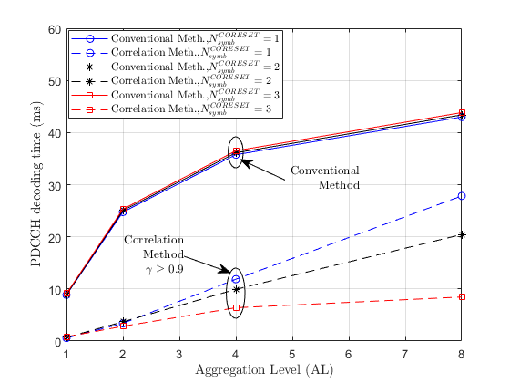
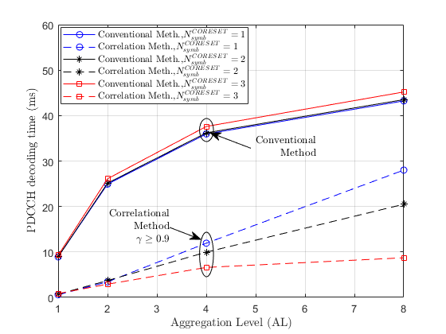
Blind Decoding of PDCCH in 5G NR
IIT Delhi, Delhi
5G Test Bed Project funded by Department of Telecommunications, Government of India
INDIAN INSTITUTE OF TECHNOLOGY, DELHI
DCI
5G BWP, CORESET, PRB
Uplink Resource Allocation
Description about DL data transmitted to the UE
Power Control
CORESET
Resource Element,
one subcarrier per
one OFDM symbol
PDCCH Payload
Physical Resource Block,
12 subcarriers per
one OFDM symbol
BWP
Example
Example
Extracting DM-RS from CCE
Design of Correlation based PDCCH Search
Simulation Results
Simulation Results
Interleaved CCE-REG Mapping
Non-Interleaved CCE-REG Mapping
This work was done in collaboration with CEWiT, IIT Madras.

