Slide 1
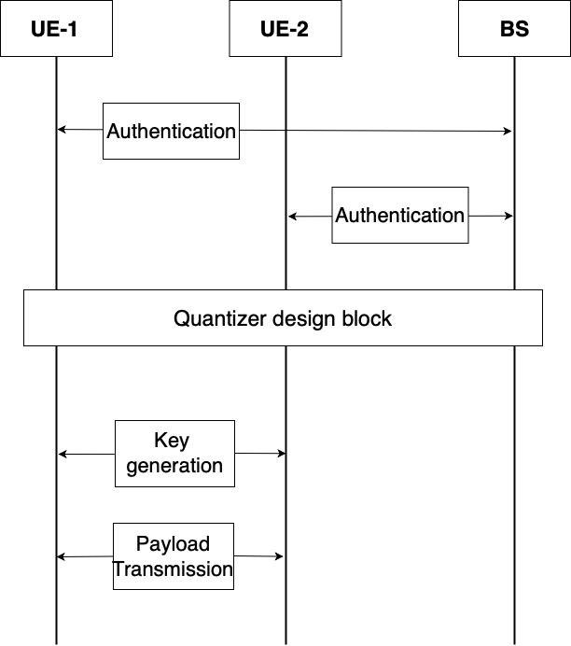
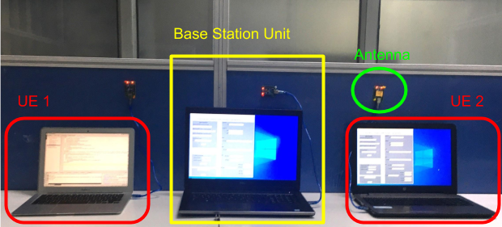
Implementation of 5G Authentication and Key Agreement Protocol on XBee Networks
5G- Security Group
Dynamic Key Generation for D2D communication
Abstract
Model
In this demonstration, we showcase a physical-layer key generation mechanism between two 5G-compliant User Equipment (UE) devices that operate in a D2D fashion. To present our ideas, we use a network of three XBee devices, wherein one of them acts as a base-station and the other two play the role of UEs. In order to ensure end-to-end privacy, the two UEs first authenticate with the base-station by using the standard 5G AKA protocol, and subsequently request the base-station to facilitate the design of a quantization algorithm, which in turn will be used by them to implement a physical-layer key generation mechanism for securing communication in the D2D mode. Our demonstration shows that key-exchange algorithms using physical-layer methods are feasible for implementation on 5G-compliant devices, and such methods should be considered to ensure end-to-end privacy for D2D communication in the 5G architecture.
UEs’ embedded secret key is used for authentication with the BSU
A set of keys compliant with 3GPP standards is derived for the two wireless links (UE-1 to BSU and UE-2 to BSU)
BSU facilitates UEs by designing appropriate quantizer for DKG by observing their joint channel characteristics
DKG scheme is then initiated to achieve end-to-end privacy
U
Dynamic Key Generation
Known pilots are exchanged between the two UEs to estimate correlated random channel state sequence (RSSI in XBees)
Base Station Unit (BSU) observes joint channel characteristics between the two UEs and designs the optimal quantizer
Both the UEs quantize their long sequences into bits with the same quantizer and apply consensus algorithm on the sequence
LDPC reconciliation is done so as to correct mismatches in bits
Zero mismatch scheme corrects every disagreement in bits
Privacy amplification compensates for public data revealed in above steps and gives random key
Keys are then used by 3GPP compliant encryption schemes for payload transmission
Testbed Setup
Testbed comprises of a Base Station Unit (BSU) and two UEs
The two authenticated UEs want to communicate to each other in the available D2D fashion
BSU facilitates them to achieve an end-to-end privacy by using DKG scheme
Advantage Distillation
Channel parameter from UE1 & UE2
Quantizer and Consensus
Bits after consensus
Information Reconciliation
Syndrome sent by UE1 to UE2
LDPC Reconciliation
Corrected bits
Privacy Amplification
Universal Hash
New random key
Acknowledgement
Shared key
This work is funded by the indigenous Test Bed project from the Department of Telecommunication, Ministry of Communication, New Delhi, India.
Reference:
S. Mathur, W. Trappe, N. B. Mandayam, C. Ye, and A. Reznik, ”Radio- telepathy: extracting a secret key from an unauthenticated wireless channel,” in ACM MobiCom ’08, September 14-19, 2008, pp. 128–139, 2008

