Slide 1
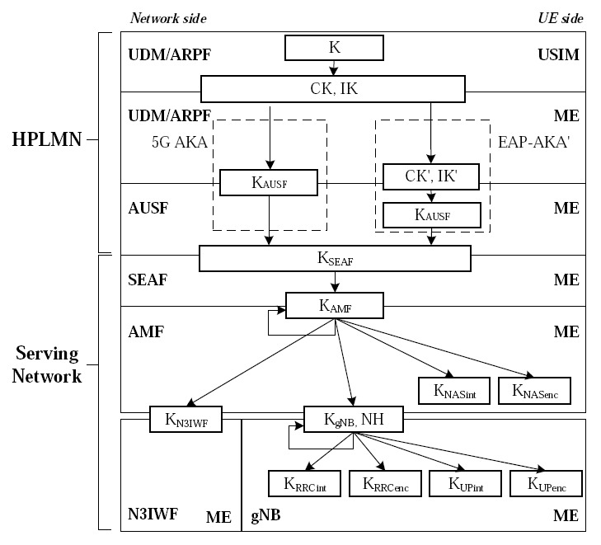
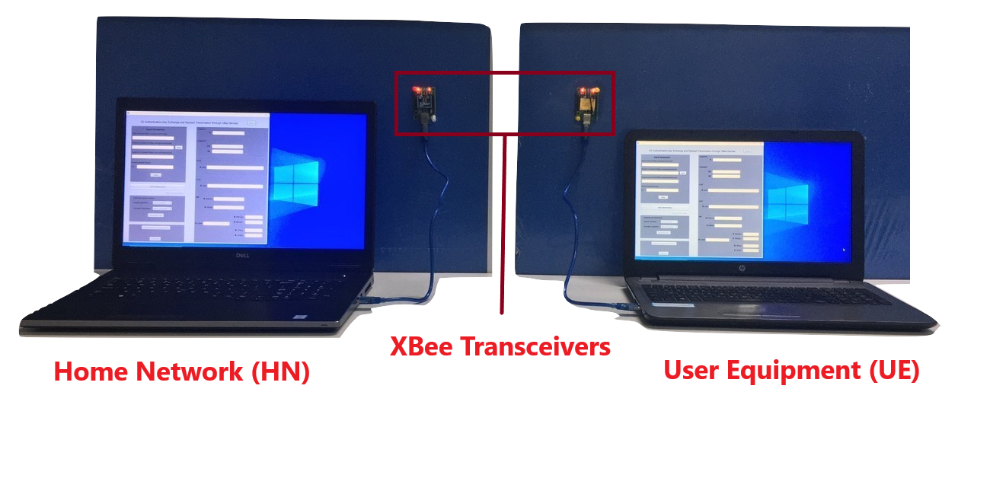
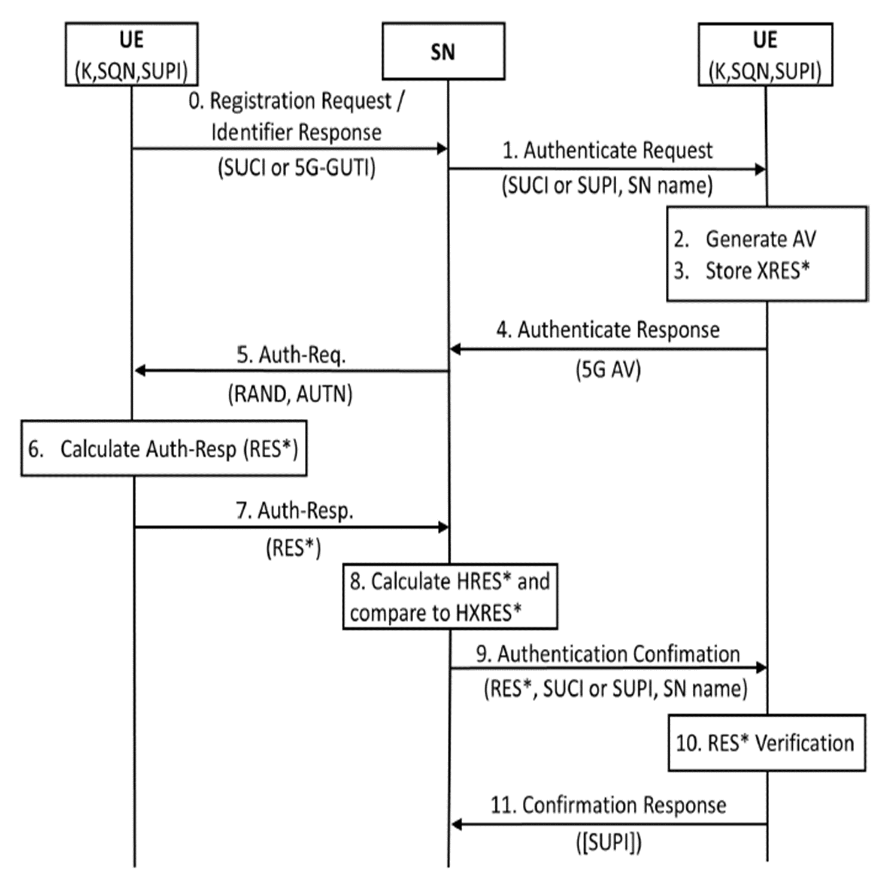
Implementation of 5G Authentication and Key Agreement Protocol on XBee Networks
5G- Security Group
ABSTRACT
This demonstration provides first hand collation and description of state-of-the-art details on 5G security architecture in a simple and unified manner. We implement the 3GPP compliant 5G-AKA protocol on a network of XBee S2C devices wherein the protocol involves a sequence of modules involving secure authentication, key exchange and payload transmission. To implement the security protocol, we extract the precise recommendations of 3GPP and also use open-source algorithms wherever the implementation.
is left open as proprietary solution.
3GPP Compliant Key Hierarchy
Test bed comprising XBee devices emulating a UE and a home network as part of 5G
4G vs 5G
Service based architecture – modularization of control plane
Use of asymmetric encryption instead of symmetric
Encryption of SUPI with public key of home operator (SUCI)
Routing information (home network ID) in clear
SUPI revealed to VPLMN only after authentication
Binding of SUPI into key
UE and HPLMN have to use the same SUPI: requested for lawful
intercept purposes
Respond to identifier request with SUCI
No SUPI based paging
KEY TAKEAWAY FROM DEMO
Collation of the essential documents required for implementation of 5G security architecture.
Implementation of 3GPP compliant, prescribed security architecture which involves authentication, key exchange and secure payload transmission.
Implementation has been done using standard devices such as XBee S2C and terminal equipment etc.
Depiction of the modular hierarchical key exchange process in home network (HN) and User equipment (UE). This is shown in the dedicated user interface developed for the demonstration.
Depiction of MAC and SYNC failure in case of non matching key between UE and HN.
3GPP compliant 5G Authentication Procedure
ACKNOWLEDGEMENT
This work is funded by the Indigenous 5G Test Bed project from the Department of Telecommunications, Ministry of Communications, New Delhi, India.
REFERENCES
[1] ETSI TS 135 206 V16.0.0 (2019-11).
[2] ETSI TS 133 501 V16.0.0 (2019-11).
[3] ETSI TS 133 102 V16.1.0 (2019-04).
[4] D. Basin, J. Dreier, L. Hirschi, S. Radomirovi ́c, R. Sasse, and V. Stettler,
“Formal analysis of 5G authentication,” ArXiv e-prints, Oct. 2018.
[5] R. P. Jover and V. Marojevic, ” Security and Protocol Exploit Analysis of 5G Specifications,” ArXiv e-prints, Nov. 2018.

