Slide 1
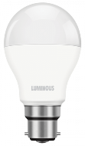
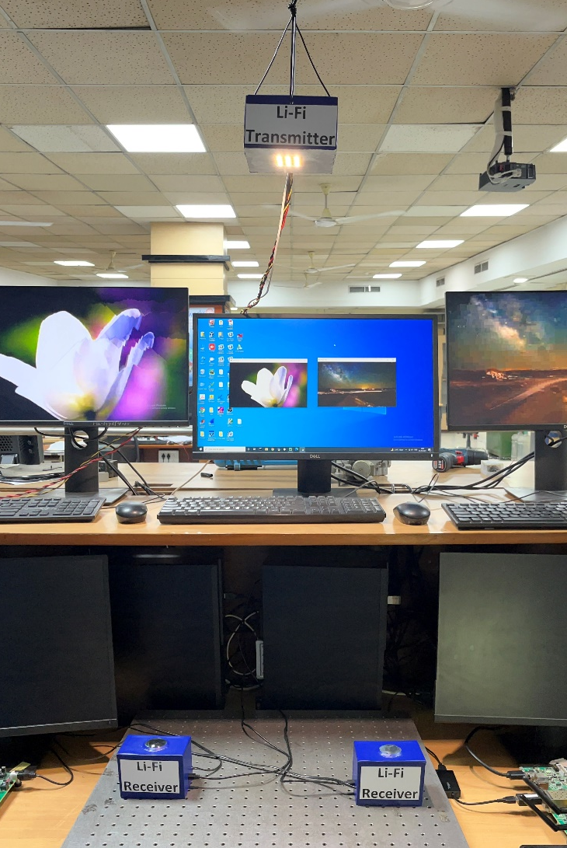
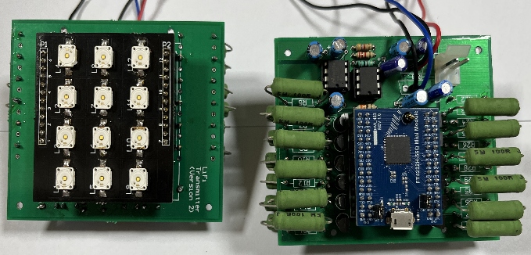
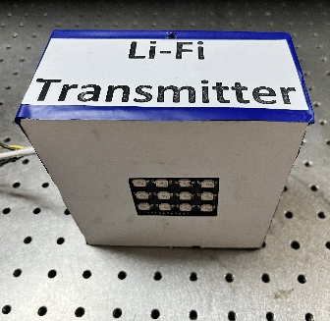
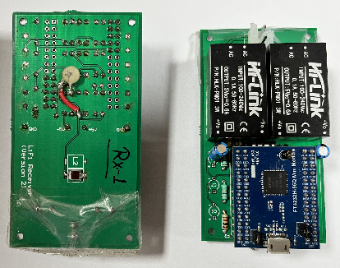
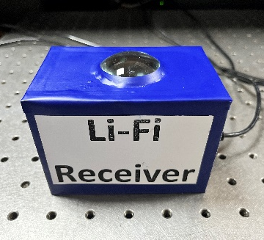
Li-Fi Networks
Achievements
Link length - 1.5 Meter
Uplink speed - 100 Mbps
Mobility support
Downlink speed - 5 Mbps
Integration with MAC
Alert System
Indoor
Wireless
Communication
RF
Interference
Sensitive
Places
Energy
Harvesting
Security
Block diagram
Li-Fi link setup
Receiver One
Transmitter
Lens
Amplification
Processing
Demodulated Data
Transmitter
Modulated Data
LED Driver
Circuit
Optical Wireless Communication
Receiver Two
Lens
Amplification
Processing
Demodulated Data
Designed Li-Fi Modules
Transmitter
Receiver
Receivers
Mobile networks
Li-Fi
Li-Fi technology is a reliable solution for 5G wireless challenges.
LED lights are used both for communication and illumination.
Light intensity is changed at a very high speed to carry information unnoticeable to human eye.
LED acts as a wireless access point.
Access point density is very high as compared to other commercially available wireless technologies.
Least probability of signal interception.
No adverse effects on humans.
Highly secure.
Green technology.
Easy implementation into the existing infrastructure.
Wi-Fi
Access Networks
PON
Aggregation Network
Core Network
…
Principal Investigator: Prof. Abhishek Dixit
Sponsored by: Ministry of Communication,
Dept. of Telecommunication, Govt. of India.

