Slide 1
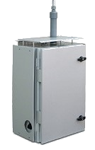
Data Rate : 375 Kbps (Max UL/DL)
MQTT Protocol supported
Public/private/hybrid cloud support
NB-IoT:
LTE FDD: B1/B2/B3/B4/B5/B8/B12/B13/B18/ B19/B20/B28
EGPRS: 850/900/1800/1900 MHz
OTHER FEATURES
*
APPLICATIONS
Smart City Development
National Air Pollution Monitoring Network
Airport Pollution Monitoring
IoT based Air Pollution
Monitoring System
Solar Panel Support
Camera Support
Measurement of SO2,NO2 and other important pollutants
FUTURE ROADMAP
For More Details please Contact:
Mob:9810032545
Email: maggarwal@care.iitd.ac.in
*-Reference Picture

Slide 2
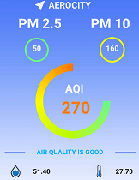
INTRODUCTION
IoT based Air Quality Monitoring System is a continuous ambient air quality monitoring systems (CAAQMS). It is an affordable compact size system having ability to support a range of connectivity options like Wifi, GSM, NB-IoT, etc.
It is a fully integrated system capable of measure different Air pollutants and meteorological parameters.
Pollutants:
O3
CO2
CO
PM2.5
PM10
Meteorological Parameters:
Temp
Humidity
Pressure
Other:
GPS location
SPECIFICATIONS
DATA VISUALIZATION
Real Time
Updates
Mobile APP
Real time continuous measurement of gaseous and particulate matters including temp, humidity, pressure as per Indian standards
Compact size
Power backup option
Data logging over cloud
Weather proof
LED display for every sensor board
Future prediction
Mobile Application
KEY FEATURES
CONNECTIVITY
Prediction using
AI/ML
Live values
Predicted values

